Slide 1

Clustering and Classification on CIA UFO Intelligence
Mike Messina
Omar Khan

Slide 2
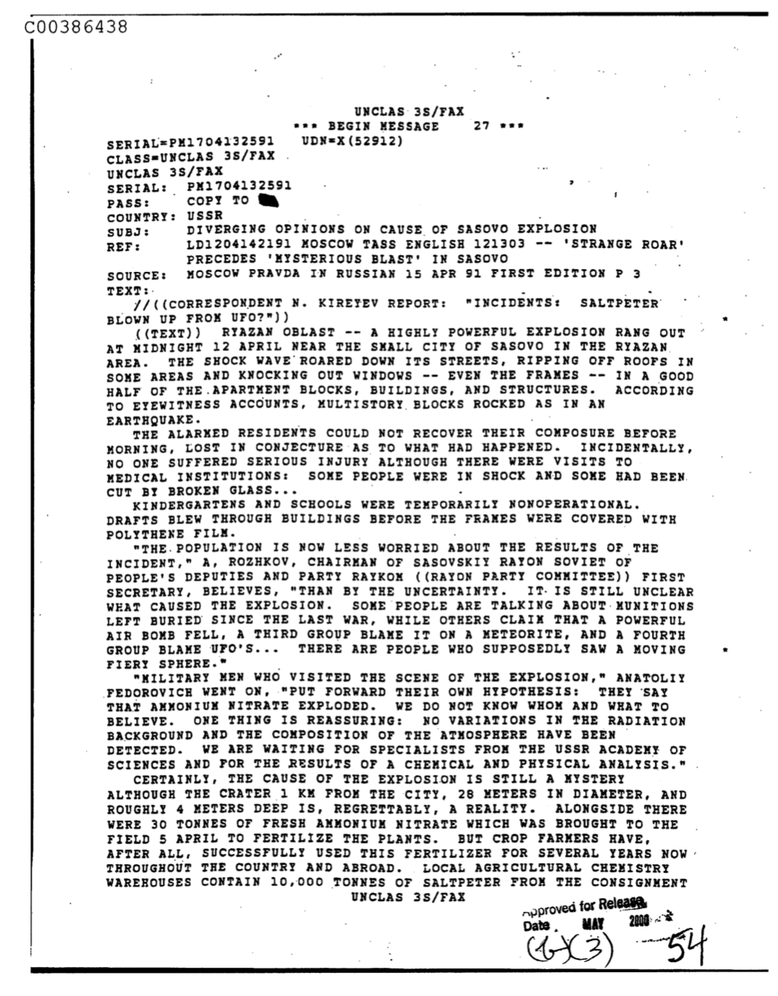
Text Analysis of a Scanned PDF
670 once classified CIA documents regarding UFOs now declassified and available to the public.
We will extract the text from each document and attempt to cluster the documents to find any useful class labels for each document.
Once we have labels for our documents, we will build classifier models to predict new documents on our labels.

Slide 3
Analysis Approach
As pure word frequencies are of little importance in this type of analysis, inverse term x document frequency categorization methods will be applied as less used words are assumed to have more importance here than words with the highest frequency in documents which may include specific scientific subject matter.
K-Nearest Neighbor (KNN) classification techniques will be used to keep explainability of the models high given the complexity of the underlying data space.
Principal Component Analysis (PCA) will also be utilized to decrease the term feature space to help fight against overfitted models given the high variance of terms.

Slide 4
Goals
Glean specific clusters of documents as a means of filtering out misleading or documents that include no useful information regarding UFOs.
Learning interpretable class labels for these documents in order to filter and decipher which are more useful than others.
Build a classification model that is able to take in a document regarding UFO intelligence and be able to predict the class labels we uncovered from clustering with above average accuracy.

Slide 5
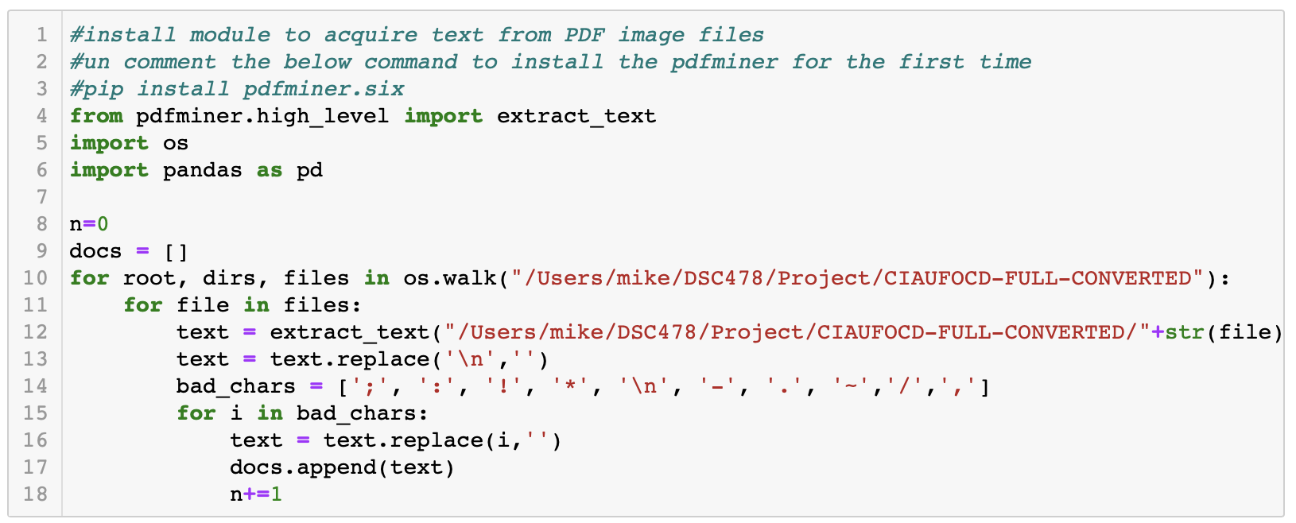
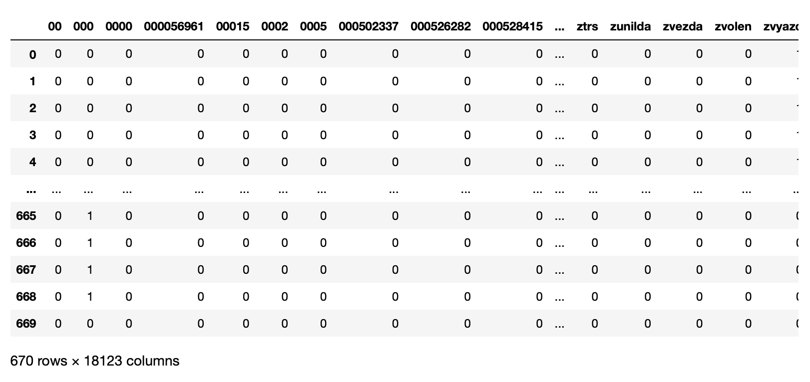
Extracting the Text
Poor scanning of the documents led to additional cleaning of our doc x term matrix.
18,123 term features were initially extracted. This needs to be reduced.

Slide 6
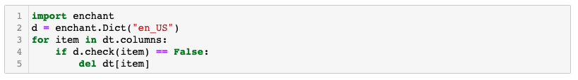
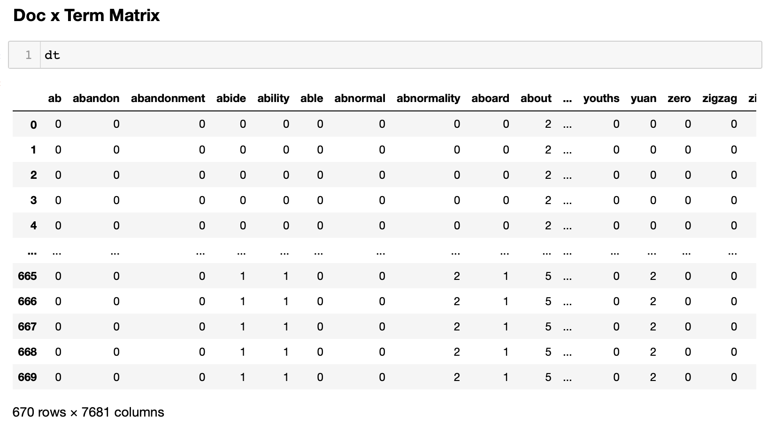
Reducing the Feature Space
After filtering out special characters and end lines, we utilized the Pyenchant python package which includes a US Dictionary library that we can utilize to filter out any non-English words.
We were able to reduce our term feature space by ~10,000 terms to 7,681 terms and a much more interpretable term space.

Slide 7
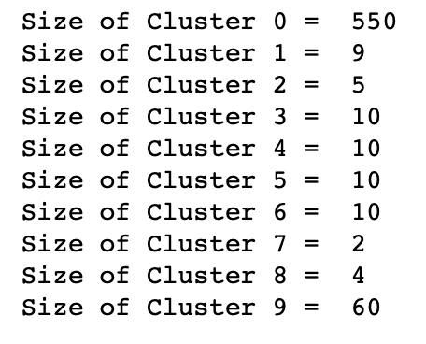
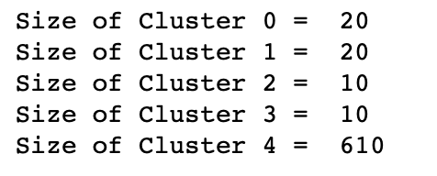
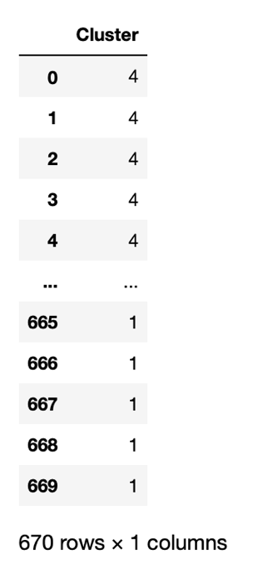
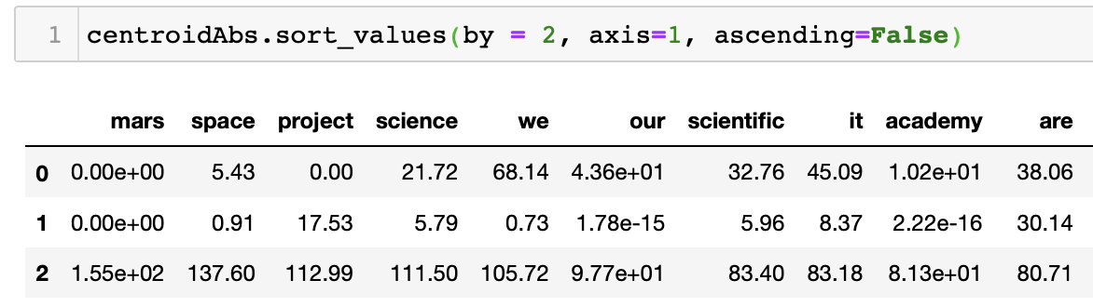
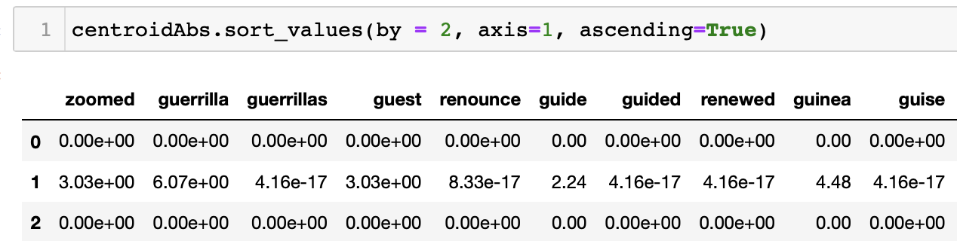
Clustering on TF-IDF Matrix
Initially tested on 10 clusters but found the majority of documents were clustered into one cluster and the other clusters were not very interpretable.
Reduced to 5 clusters which still clustered the majority (92%) of the documents into one cluster but the contents of five clusters are much more explainable than ten.
For example, Cluster 2 contains terms like mars, space, project, science, etc but also terms that begin with “gu”. Cluster 2 could be holding documents relating to extraterrestrial subjects but also seems to be incorporating some noise.

Slide 8
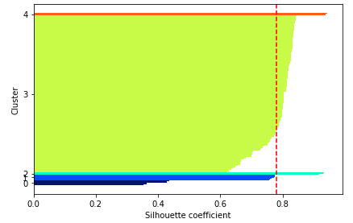

Average Silhouette Value
Silhouette value ranges from -1 to 1. An average value of .78 means our documents are actually pretty well matched to their own clusters and separated from other clusters even though the majority of the documents were put into one cluster.
The chart to the right allows us to view the silhouette values of each cluster. Cluster 0 has the value closest to zero (documents not as well matched to one another) while the other four clusters all have silhouette values around the average of .78 suggesting the documents in these clusters are well matched.

Slide 9
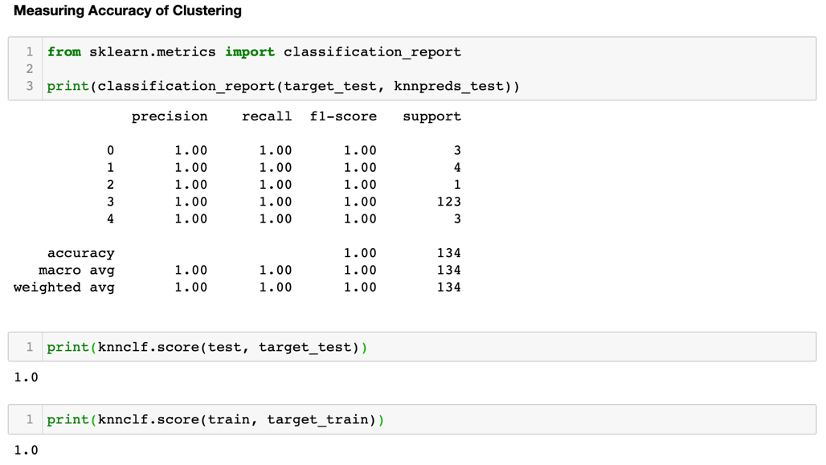
Classification on TF-IDF Clusters
Using a 20/80 test/train split, we utilized the neighbors module from sklearn with the nearest 5 neighbors to predict class labels.
As shown in the accuracy metrics above, we don't like seeing a perfect accuracy score from our Classification. This is most likely due to our model being highly overfit due to the amount of noise in our dataset from filler and stop words that are affecting the cluster labels.
We need to further reduce the term feature space to combat this.

Slide 10
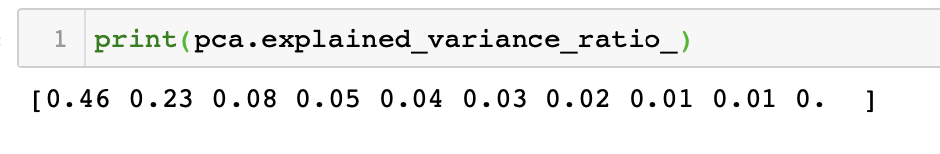
PCA
As our term feature space is so large and filled with noise, we will attempt to reduce this dimension by computing principal components on the dataset.
We utilized the sklearn decomposition module to compute the principal components and found four PCs are needed to explain 83% of the variance in our data.

Slide 11
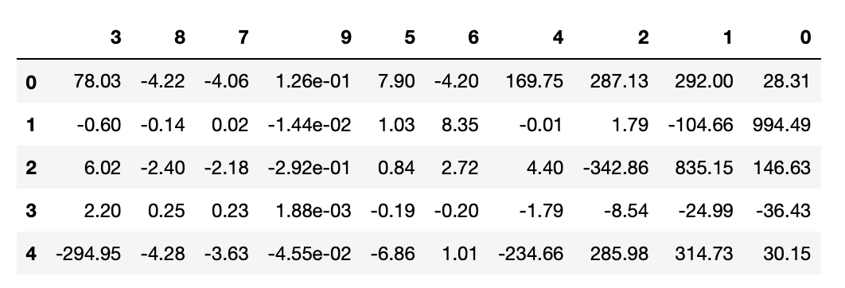


Clustering on PCA Dataspace
We obtained extremely similar results to when we clustered on the TFxIDF matrix where 92% of our documents were clustered into one cluster.
Aside from suggesting that there is too much noise in our dataset, we can also determine that these 610 documents could hold the most important/similar information from the other 60 documents.

Slide 12
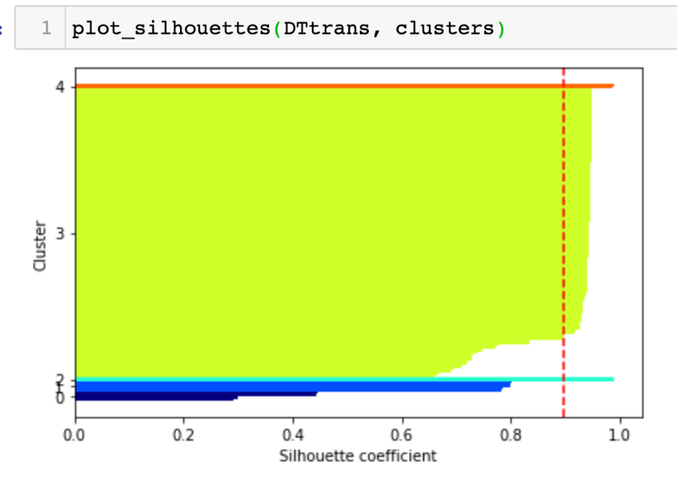
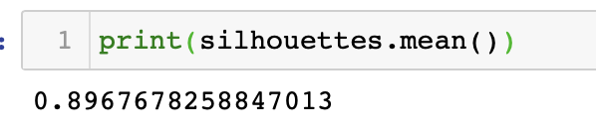
Average Silhouette Value
Average silhouette value of .89 to measure the cohesion (intra) and separation (inter) of our clusters.
higher than the .78 value we got when we clustered on our TFxIDF values suggesting that our documents are actually better matched to their own clusters and separated from other clusters even though each of the five clusters hold the same number of documents as our clustering on TFxIDF.

Slide 13
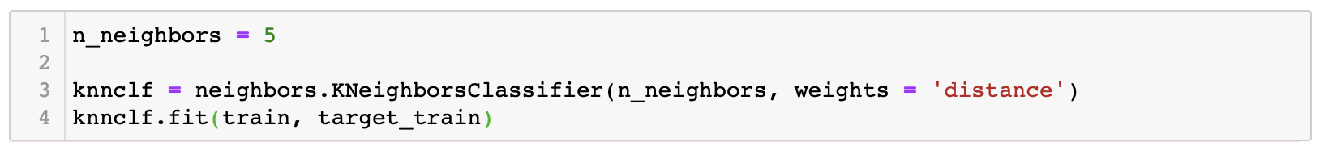
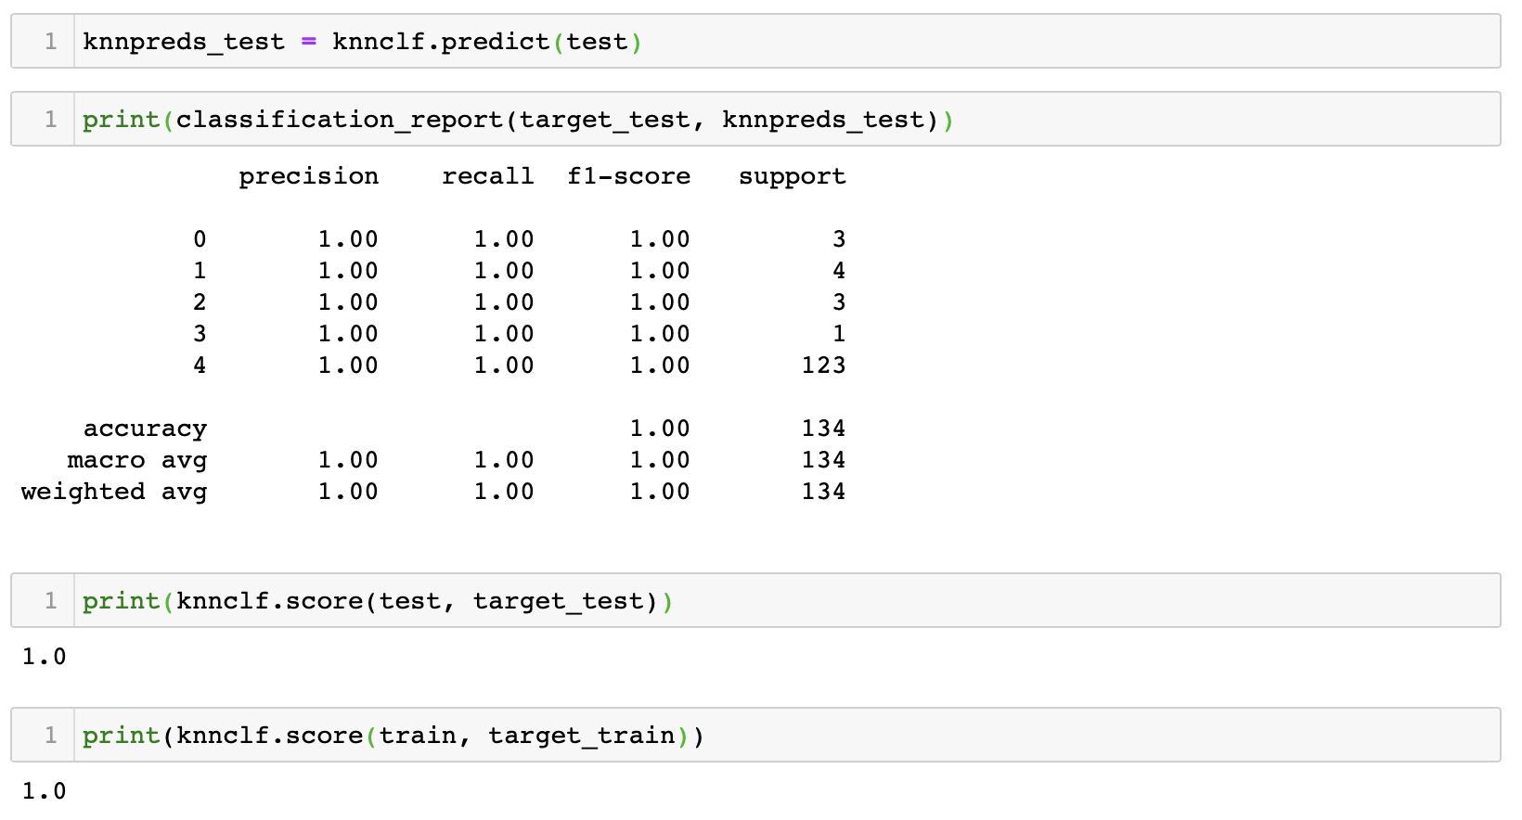
Classification on PCA Clusters
After fitting the model on 80% of our PCA data matrix, we are also getting 100% accuracy in predicting the class labels of each of our documents in the test and train set.
Another signal that our model is overfitting even with the reduced dimensionality given by PCA.

Slide 14
Takeaways
At the start, we stated that amongst the entirety of all the documents released by the CIA on UFOs, only a portion of that documentation would contain any pertinent information.
The end result was inline with our predictions, a large majority of the sampled documents fell into one cluster so we can identify those documents specifically and present them as targets for potential future analysis.
Moving forward, sentiment analysis and word embedding ML applications can be applied to the CIA documents in an attempt to see if we can create our own readable documents based on the characteristics of the CIA documents.
Further reducing the feature dimensions of our dataset would most likely yield improved classification and clustering results. The PDF files being poorly scanned also contributed to poor text extraction of a lot of terms.

